Slide 1
Normal Forms
Part 2

Slide 2
Content
Normalization of Relations
Practical Use of Normal Forms
Definitions of Keys and Attributes Participating in Keys
First Normal Form
Second Normal Form
Third Normal Form
Normal Forms
2

Slide 3
Normalization of Relations (1)
Normalization: The process of decomposing unsatisfactory "bad" relations by breaking up their attributes into smaller relations
Normal form: Condition using keys and FDs of a relation to certify whether a relation schema is in a particular normal form
  2NF, 3NF, BCNF based on keys and FDs of a relation schema
  4NF based on keys, multi-valued dependencies;
Normal Forms

Slide 4
Practical Use of Normal Forms
Normalization is carried out in practice so that the resulting designs are of high quality and meet the desirable properties
The practical utility of these normal forms becomes questionable when the constraints on which they are based are hard to understand or to detect
The database designers need not normalize to the highest possible normal form. (usually up to 3NF, BCNF or 4NF)
Normal Forms

Slide 5
Definitions of Keys and Attributes Participating in Keys (1)
A superkey of a relation schema R = {A₁, A₂, ...., A_{n}} is a set of attributes S subset-of R with the property that no two tuples t₁ and t₂ in any legal relation state r of R will have t₁[S] = t₂[S]
A key K is a superkey with the additional property that removal of any attribute from K will cause K not to be a superkey any more.
Normal Forms

Slide 6
Definitions of Keys and Attributes Participating in Keys (2)
If a relation schema has more than one key, each is called a candidate key. One of the candidate keys is arbitrarily designated to be the primary key, and the others are called secondary keys.
A Prime attribute must be a member of some candidate key
A Nonprime attribute is not a prime attribute—that is, it is not a member of any candidate key.
Normal Forms

Slide 7
First Normal Form
Disallows composite attributes, multivalued attributes, and nested relations; attributes whose values for an individual tuple are non-atomic
Normal Forms

Slide 8
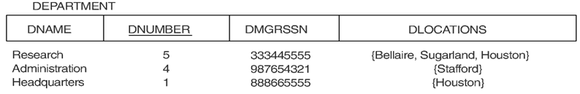
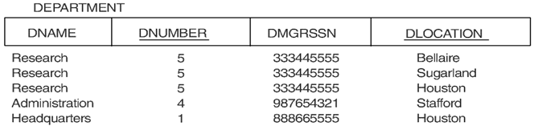
Relation schema that is not in 1NF
Example relation instance
1NF with redundancy
Normal Forms

Slide 9

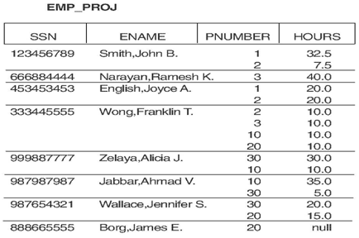
EMP_PROJ relation with nested relation PROJS
Normal Forms

Slide 10
Second Normal Form (1)
Uses the concepts of FDs, primary key
Definitions:
Prime attribute - attribute that is member of the primary key K
Full functional dependency - a FD Y ➔ Z where removal of any attribute from Y means the FD does not hold any more
Examples:
- {SSN, PNUMBER} ➔ HOURS is a full FD since neither SSN ➔ HOURS nor PNUMBER ➔ HOURS hold
- {SSN, PNUMBER} ➔ ENAME is not a full FD (it is called a partial dependency ) since SSN ➔ ENAME also holds
Normal Forms

Slide 11
Second Normal Form (2)
A relation schema R is in second normal form (2NF) if every non-prime attribute A in R is fully functionally dependent on the primary key
R can be decomposed into 2NF relations via the process of 2NF normalization
Normal Forms

Slide 12
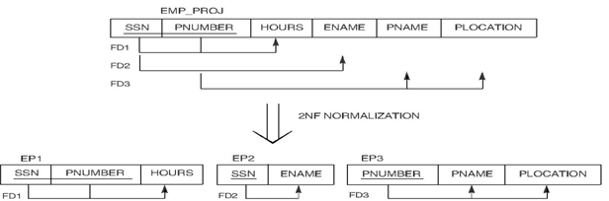
Normalizing EMP_PROJ in the 2NF
Normal Forms

Slide 13
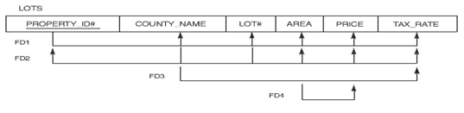
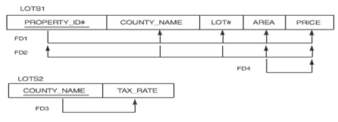
Normalizing LOTS in the 2NF
Normal Forms

Slide 14
Third Normal Form (1)
Definition:
Transitive functional dependency - a FD X ➔ Z that can be derived from two FDs
X ➔ Y and Y ➔ Z
Examples:
- SSN ➔ DMGRSSN is a transitive FD since
SSN ➔ DNUMBER and DNUMBER ➔ DMGRSSN hold
- SSN ➔ ENAME is non-transitive since there is no set of attributes X where SSN ➔ X and X ➔ ENAME
Normal Forms

Slide 15
Third Normal Form (2)
A relation schema R is in third normal form (3NF) if it is in 2NF and no non-prime attribute A in R is transitively dependent on the primary key
R can be decomposed into 3NF relations via the process of 3NF normalization
NOTE:
In X ➔ Y and Y ➔ Z, with X as the primary key, we consider this a problem only if Y is not a candidate key. When Y is a candidate key, there is no problem with the transitive dependency .
E.g., Consider EMP (SSN, Emp#, Salary ).
Here, SSN ➔ Emp# ➔ Salary and Emp# is a candidate key.
Normal Forms

Slide 16
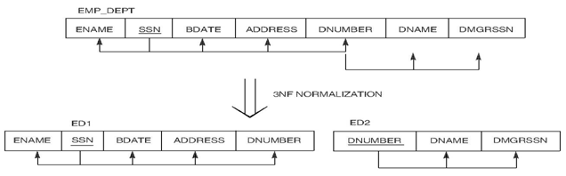
Normalizing EMP_DEPT in the 3NF
Normal Forms

Slide 17

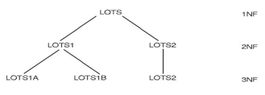
Normalizing LOTS1 in the 3NF
Normal Forms

Slide 18
General Normal Form Definitions (For Multiple Keys) (1)
The above definitions consider the primary key only
The following more general definitions take into account relations with multiple candidate keys
A relation schema R is in second normal form (2NF) if every non-prime attribute A in R is fully functionally dependent on every key of R
Normal Forms

Slide 19
General Normal Form Definitions (2)
Definition:
Superkey of relation schema R - a set of attributes S of R that contains a key of R
A relation schema R is in third normal form (3NF) if whenever a FD X ➔ A holds in R, then either:
(a) X is a superkey of R, or
(b) A is a prime attribute of R
NOTE: Boyce-Codd normal form disallows condition (b) above
Normal Forms

Slide 20
BCNF (Boyce-Codd Normal Form)
A relation schema R is in Boyce-Codd Normal Form (BCNF) if whenever an FD X ➔ A holds in R, then X is a superkey of R
Each normal form is strictly stronger than the previous one
  Every 2NF relation is in 1NF
  Every 3NF relation is in 2NF
  Every BCNF relation is in 3NF
There exist relations that are in 3NF but not in BCNF
The goal is to have each relation in BCNF (or 3NF)
Normal Forms

Slide 21
Lossless Decomposition
All attributes of an original schema (R) must appear in the decomposition (R₁, R₂):
R = R₁ ∪ R₂
Lossless-join decomposition.
For all possible relations r on schema R
r = ∏_{R1} (r) ►◄ ∏_{R2} (r)
A decomposition of R into R₁ and R₂ is lossless join if and only if at least one of the following dependencies is in F⁺:
  R₁ ∩ R₂ → R₁ or R₁ ∩ R₂ → R₂
Normal Forms

Slide 22

Objective of the normalization process
Lossless-join decomposition: Otherwise decomposition would result in information loss.
No redundancy: The relations R_{i} preferably should be in either Boyce-Codd Normal Form or Third Normal Form.
Dependency preservation: Let F_{i} be the set of dependencies F⁺ that include only attributes in R_{i}.
  Preferably the decomposition should be dependency preserving, that is, (F₁ ∪ F₂ ∪ … ∪ F_{n})⁺ = F⁺
  Otherwise, checking updates for violation of functional dependencies may require computing joins, which is expensive.
Normal Forms

Slide 23
Example of BCNF Decomposition
R = (branch-name, branch-city, assets,
customer-name, loan-number, amount)
F = {branch-name → assets branch-city
loan-number → amount branch-name}
Key = {loan-number, customer-name}
Decomposition
  R1 = (branch-name, branch-city, assets)
  R2 = (branch-name, customer-name, loan-number, amount)
  R3 = (branch-name, loan-number, amount)
  R4 = (customer-name, loan-number)
Final decomposition
R1, R3, R4
Normal Forms

Slide 24
BCNF and Dependency Preservation
It is not always possible to get a BCNF decomposition that is
dependency preserving
R = (J, K, L)
F = {JK → L, L → K }
Two candidate keys JK and JL
R is not in BCNF
Any decomposition of R will fail to preserve
JK → L
Normal Forms

Slide 25
Comparison of BCNF and 3NF
It is always possible to decompose a relation into relations in 3NF and
  the decomposition is lossless
  the dependencies are preserved
It is always possible to decompose a relation into relations in BCNF and
  the decomposition is lossless
  it may not be possible to preserve dependencies.
Normal Forms

Slide 26
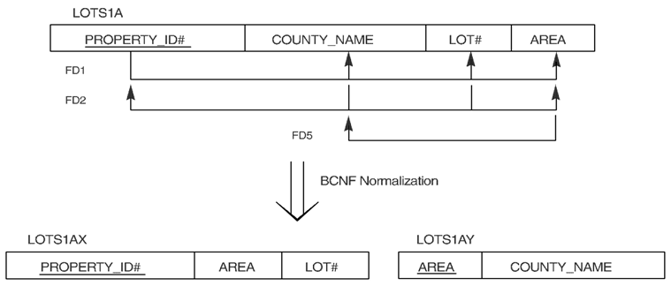
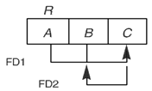
A BCNF normalization of FD2 lost in the decomposition
A relation in 3NF but not in BCNF
Normal Forms

Slide 27

A relation in 3NF but not in BCNF
Normal Forms

Slide 28
Achieving the BCNF by Decomposition (1)
Two FDs exist in the relation TEACH:
fd1: { student, course} ➔ instructor
fd2: instructor ➔ course
{student, course} is a candidate key for this relation
this relation is in 3NF but not in BCNF
A relation NOT in BCNF should be decomposed so as to meet this property, while possibly forgoing the preservation of all functional dependencies in the decomposed relations.
Normal Forms

Slide 29
Achieving the BCNF by Decomposition (2)
Three possible decompositions for relation TEACH
  {student, instructor} and {student, course}
  {course, instructor } and {course, student}
  {instructor, course } and {instructor, student}
All three decompositions will lose fd1. We have to settle for sacrificing the functional dependency preservation. But we cannot sacrifice the non-additivity property after decomposition.
Out of the above three, only the 3rd decomposition will not generate spurious tuples after join.(and hence has the non-additivity property).
A test to determine whether a binary decomposition (decomposition into two relations) is nonadditive (lossless)
Verify that the third decomposition above meets the property.
Normal Forms

